Slide 1



Malnutrition Analysis
Submitted by – rakesh panigrahy

Slide 2
Problem statements
How much countries are effected due to malnutrition.
Change in malnutrition curve over the year.
How income effects the malnutrition in each country.
Malnutrition rate with respect to the number of survey.
How much cases reported by different sources.

Slide 3
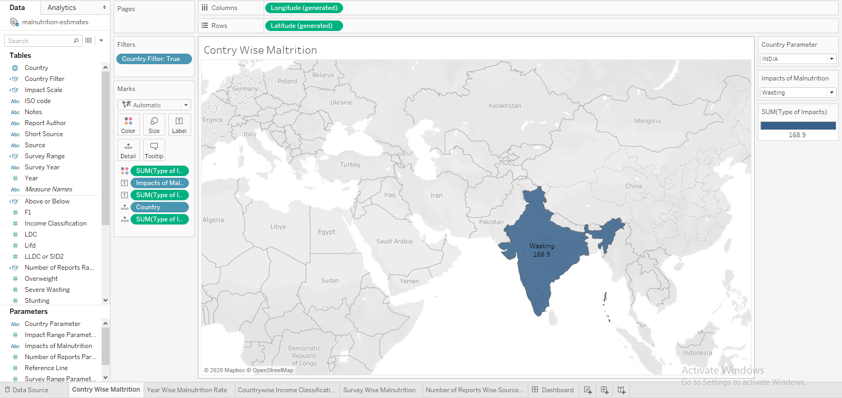
1. How much countries are effected due to malnutrition.

Slide 4
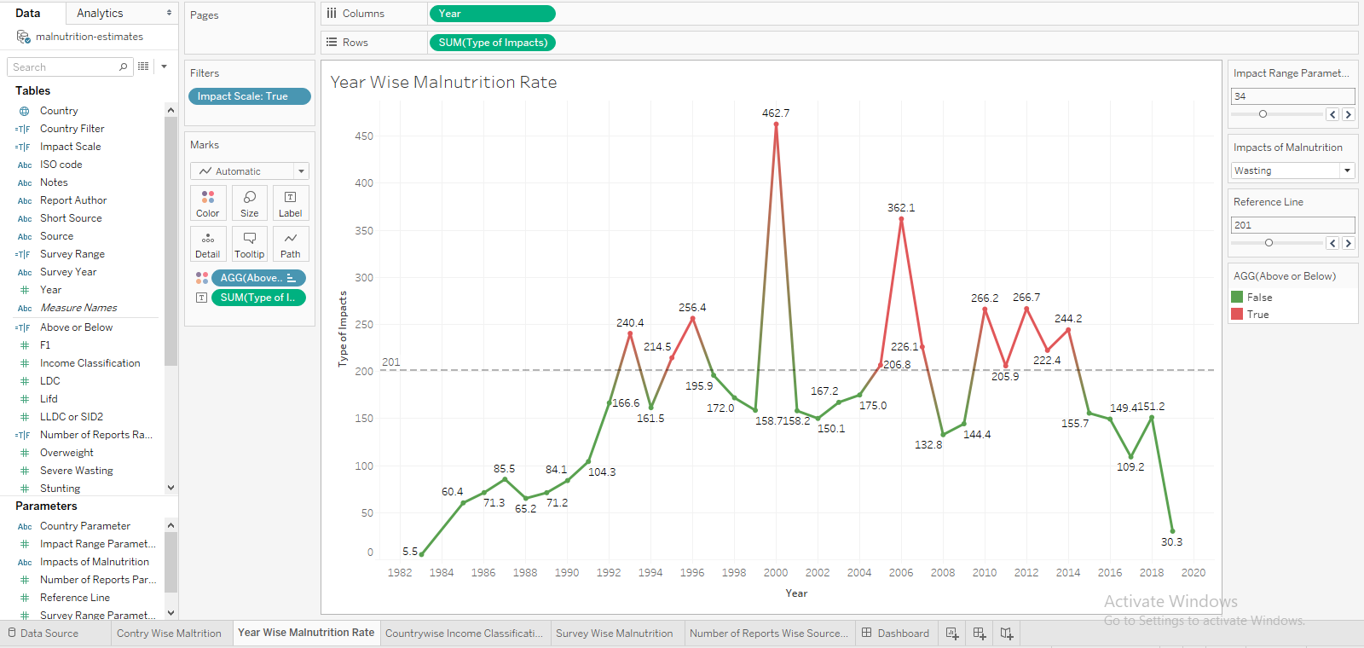
2.Change in malnutrition curve over the year.

Slide 5
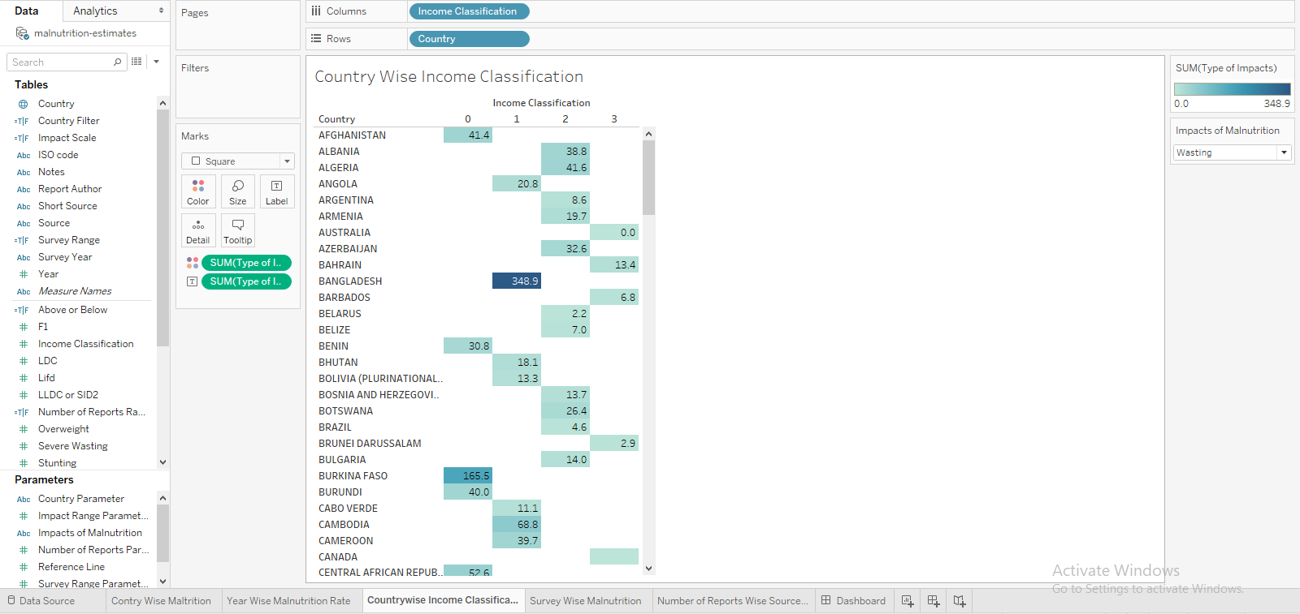
3.How income effects the malnutrition in each country.

Slide 6
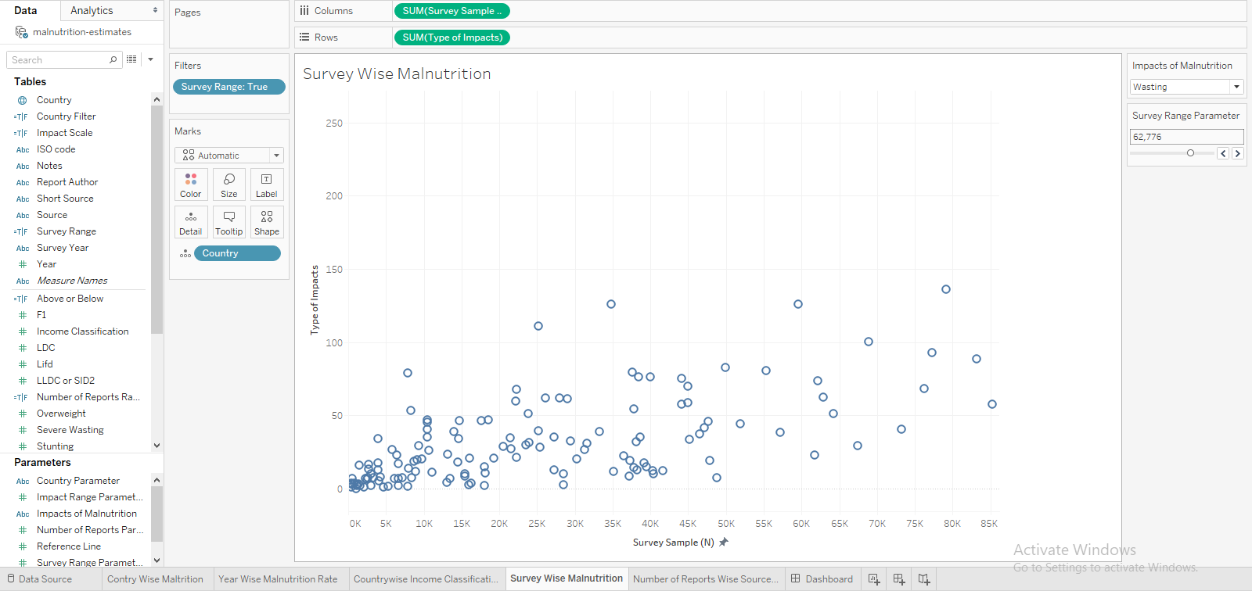
4. Malnutrition rate with respect to the number of survey.

Slide 7
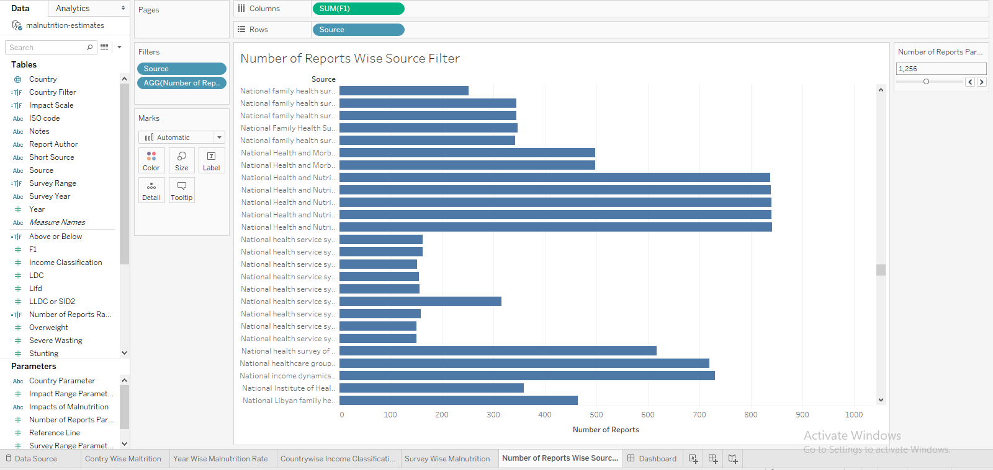
5. How much cases reported by different sources.

Slide 8
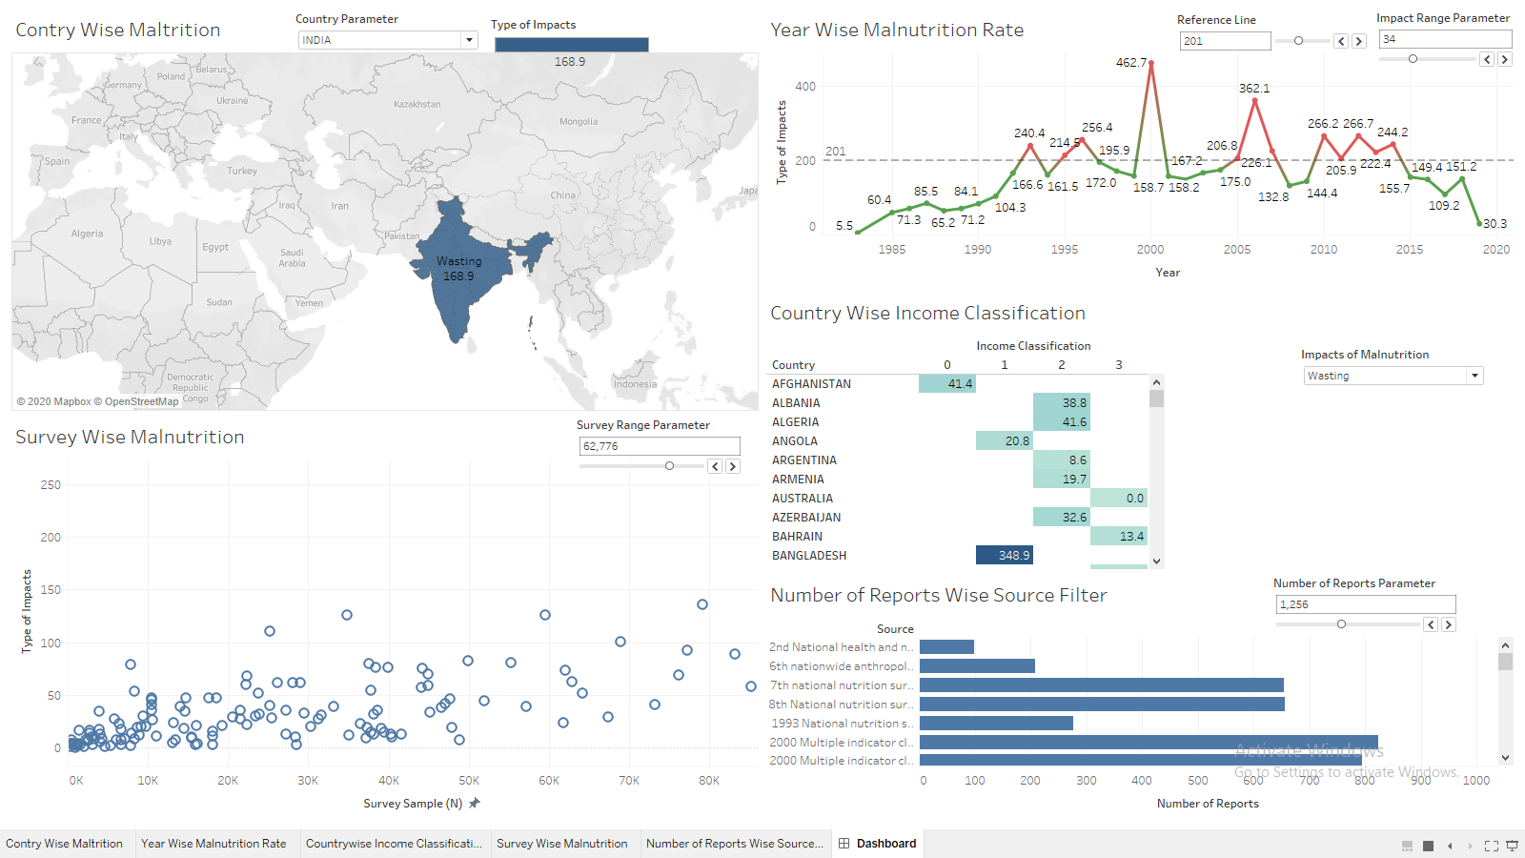
Dashboard

Slide 9

summary
Different kind of charts are visualized in order to get solution of different problem statements.
Dashboard is created to try out different parameters to get more insight into the data.

Slide 10

Conclusion
The stunting curve is increased over year.
Bangladesh is mostly effected due to stunting. Other parameters can also be checked one by one.
From number of survey wise malnutrition chart, it seems like the stunting rate is directly proportional
to the number of survey
From the reports and source wise filter it is easily identifiable, which has reported how much number
of cases.
The country wise malnutrition map represents
an easy way to understand different malnutrition
parameters.

Slide 11
Reference links
Dataset Link :)
https://www.kaggle.com/ruchi798/malnutrition-across-the-globe
Tableau Public Link :)
https://public.tableau.com/profile/rakesh.panigrahy#!/vizhome/MalnutritionAnalysis_15912918841550/Dashboard

